Slide 1
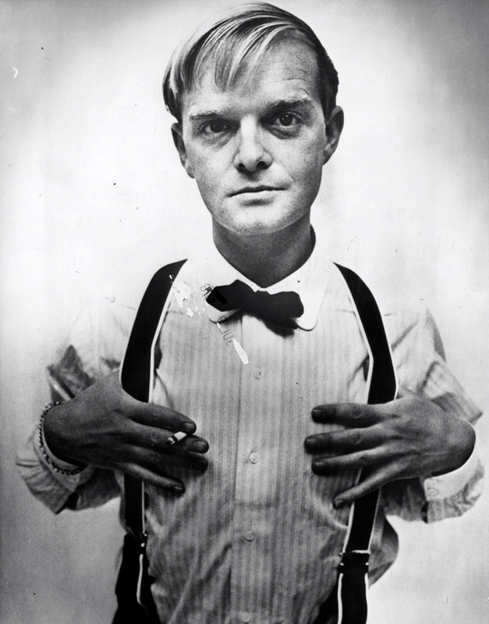
In Cold Blood Final Paper:
Read the interview with Truman Capote about the novel. Develop an opinion on his responses (do you believe him or not).
Then, in a well-written paper in MLA format respond to his claims. Your paper should be 3-4 pages in length (double spaced) and must include a rough draft.
You must also include enough textual evidence to support your claims.
Rough Draft Due for Review:
Monday, October 6 (HARD COPY)
Final Draft Due:
Friday, October 10

Slide 2
Step One
Read George Plimpton’s interview of Truman Capote and highlight Capote’s responses you find interesting.
You may want to focus on Capote’s insights into writing and the idea of the non-fiction novel in particular.

Slide 3
Step Two
With a partner or in a triad work your way through the interview asking these questions.
Which of Capote’s points are debatable?
Which of Capote’s points are obvious to readers of the novel providing ample evidence for discussion?

Slide 4
Argumentative Point Based on Interview | Do you agree or disagree with Capote? Why? | Page numbers with textual evidence from In Cold Blood
* You don’t need to include all planning points in your paper

Slide 5
Analysis Imposter
Capote says that Mr. Clutter was “entitled to rank among the local patricians, but just as he had never joined the Garden City Country Club, he had never sought to associate with the reigning coterie…their pleasures were not his; he had not use for card games, golf, cocktails, of buffet suppers served at ten—or indeed, for any pastime that he felt did not ‘accomplish something’” (Capote 34). This means that Mr. Clutter could have been a member of the country club, but he did not like wasting time on activities like card games and golf. He wanted to spend his time accomplishing work on the farm. Capote uses a long list to show possible ways Mr. Clutter could waste his time. This is because other people find lots of ways to waste time, but Mr. Clutter doesn’t waste time.
This paragraph is an analysis imposter because it does very little beyond restating the quote and therefore is just a paraphrase. It is focused on the meaning of the text and doesn’t explore WHY he does these things or includes rhetorical appeals and devices.

Slide 6
Actual Analysis
Herb Clutter, the first major principal described by Capote, is painted as archetypal hero of the American West. Capote uses folksy diction when stating that “Mr. Clutter cut a man’s-man figure” and that his teeth were “strong enough to shatter walnuts.” However, Mr. Clutter’s “square-jawed, confident face” is just the first indication that this man “always certain of what he wanted from the world” would “in large measure” obtain it. Capote carefully selects details from Mr. Clutter’s list of accomplishments to link him with Kansas State University, the Methodist Church, and even President Eisenhower. To lend further credibility to Mr. Clutter, Capote points out his wedding ring finger had been “once mangled by a piece of farm machinery.” Providing this detail serves two roles. First, it proves that Mr. Clutter is a hard-working and “hands-on” farmer. Secondly, Capote uses the mangled ring-finger metaphor as a transition into a discussion of Mr. Clutter’s loyalty to his wife despite her mental and physical frailties (Capote 6).

